Slide 1
Isotopes
September 2016

Slide 2
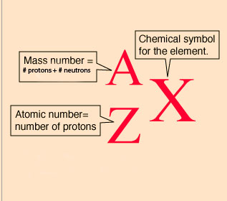
Standard Atomic Notation

Slide 3
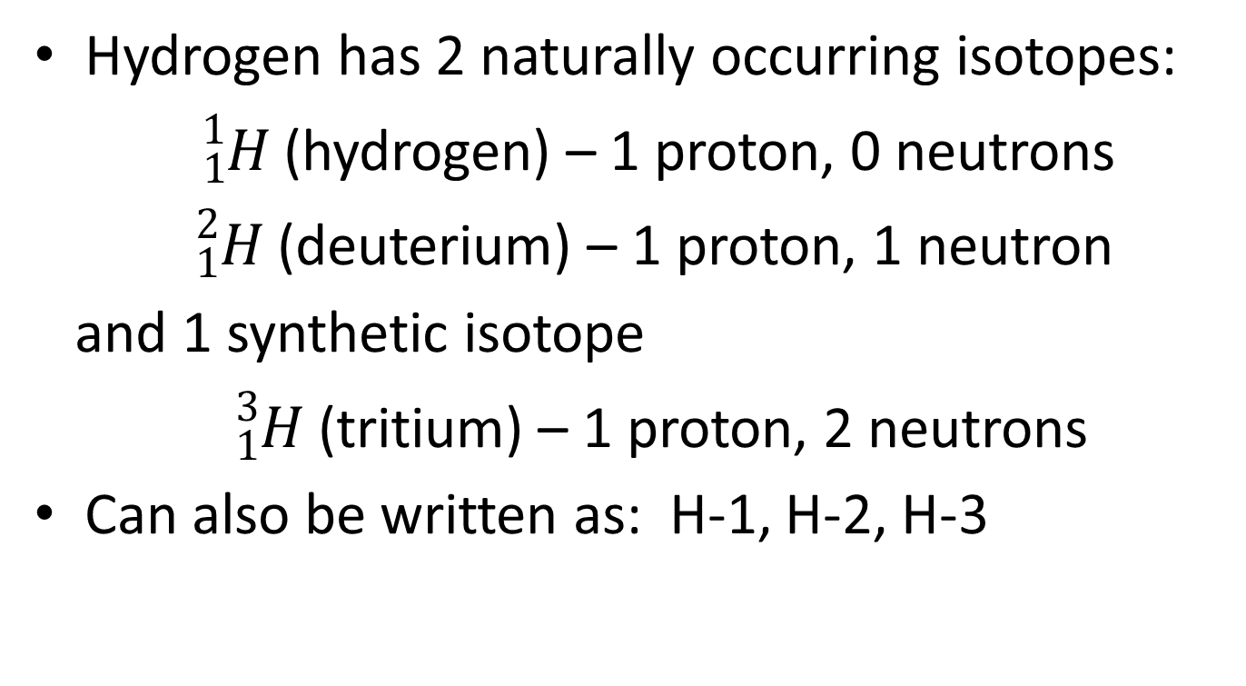
Isotopes: atoms of the same element with a different number of neutrons
Hydrogen has 2 naturally occurring isotopes:
${}_{ 1}^{1}H$ (hydrogen) – 1 proton, 0 neutrons
${}_{1}^{2}H$ (deuterium) – 1 proton, 1 neutron
and 1 synthetic isotope
${}_{1}^{3}H$ (tritium) – 1 proton, 2 neutrons
Can also be written as: H-1, H-2, H-3

Slide 4
Occurrence of Isotopes
Some elements have no naturally occurring isotopes – i.e. sodium and aluminum
Barium has 7 naturally occurring isotopes: Ba-130, Ba-132, Ba-134, Ba-135, Ba-136, Ba-137, Ba-138
Some isotopes are unstable – these are called radioisotopes – i.e. Ba-128

Slide 5
Radioisotopes
Are isotopes with unstable nuclei
Over time the nucleus decays and emits energy (radiation)
How long it takes for it to decay is called its half-life

Slide 6
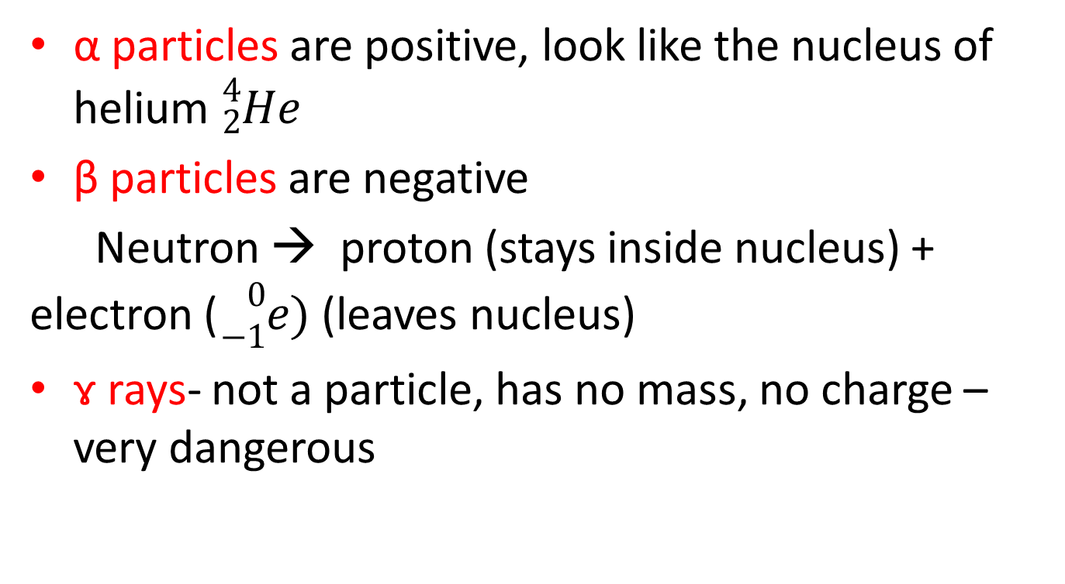
Three main types of radiation can be emitted from the nucleus: alpha (α), beta (β) and gamma (ɤ)
α particles are positive, look like the nucleus of helium ${}_{2}^{4}{He}$
β particles are negative
Neutron → proton (stays inside nucleus) + electron (${}_{−1}^{0}{e)}$ (leaves nucleus)
ɤ rays- not a particle, has no mass, no charge – very dangerous

Slide 7

Natural decay of radioisotopes:
${}_{92}^{238}U$ → ${}_{90}^{234}{Th}$ + ______ + ɤ
${}_{90}^{234}{Th}$ → ${}_{91}^{234}{Pa}$ + _______ + ɤ

