Slide 1
Models of the Atom
SCH3U

Slide 2
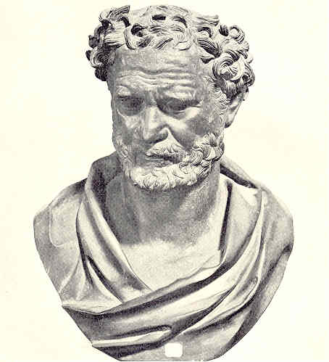
Democritus 400 BC
Atom = indivisible = smallest unit of matter

Slide 3
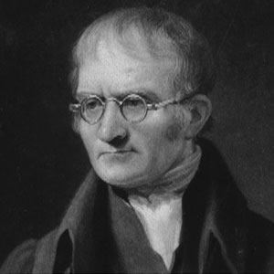

John Dalton 1800

Slide 4
Dalton’s Atomic Theory
All matter composed of atoms – small indivisible particles
Atoms can’t be created or destroyed
All atoms in an element are identical
Atoms in different elements are different
Atoms combine in whole number ratios to form compounds

Slide 5
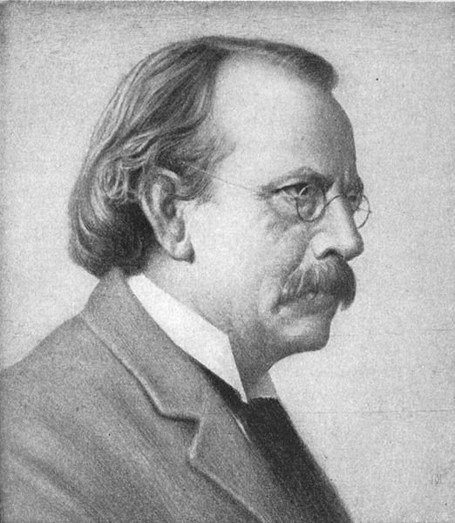
J. J. Thomson 1897

Slide 6
1897
Thomson discovers that atoms contain negatively charged particles called
electrons

Slide 7
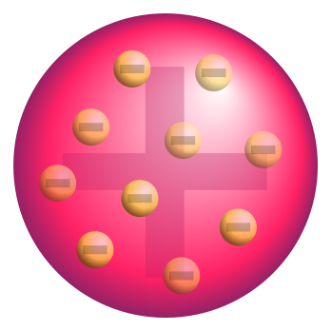
Thomson’s Model of the Atom

Slide 8

Nagaoka’s Model 1904

Slide 9
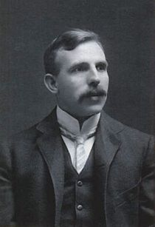
Ernest Rutherford 1911

Slide 10
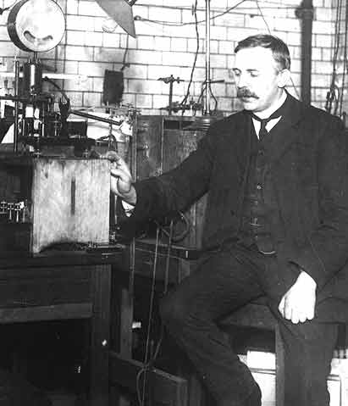
Rutherford’s Gold Foil Experiment

Slide 11
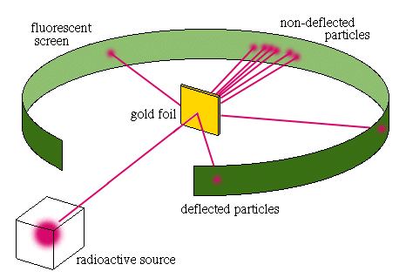
Rutherford’s Gold Foil Experiment

Slide 12
Results of Rutherford’s Experiment
Note: alpha particles are positive particles
1) He found that most of the alpha particles went straight through the foil unaffected
2) A very few particles were deflected slightly from their path
3) 1 in 20 000 particles were strongly deflected from their path (90º or more)

Slide 13
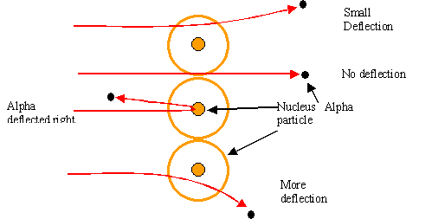
Rutherford’s Results Explained

Slide 14
Rutherford’s Conclusions
Most of the atom is empty space
The centre of the atom, the nucleus, is positively charged and contains most of the mass of the atom
Since only a very few alpha particles were affected by the nucleus, it must very small
His model is often called the “nuclear model of the atom”
Notes:
atom

Slide 15
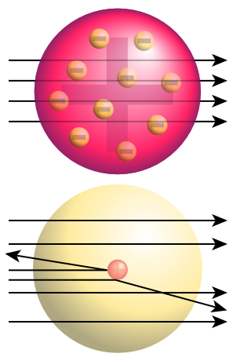
Thomson’s model vs Rutherford’s

Slide 16
1918
Rutherford discovers that atoms contain positively charged particles called
protons

Slide 17
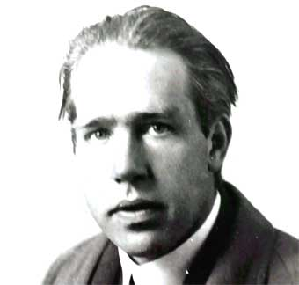
Neils Bohr 1922

Slide 18
Electromagnetic Radiation
Waves of energy travelling through space at the speed of light
The shorter the wavelength the higher the energy

Slide 19
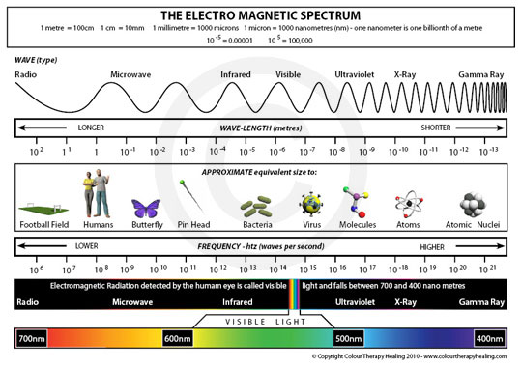
Electromagnetic Radiation

Slide 20
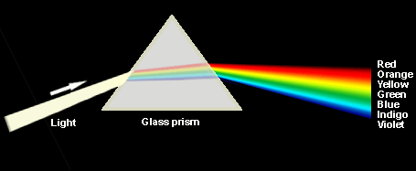
White Light

Slide 21
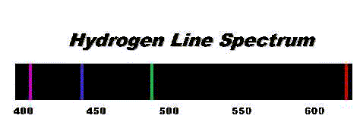
Bohr’s Model of the Atom
Developed to explain the line spectrum of hydrogen

Slide 22
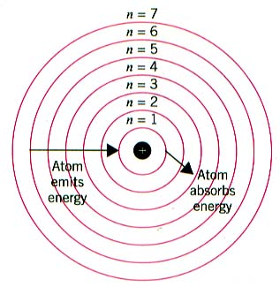
Bohr’s Model of the Atom

Slide 23
Bohr’s Model of the Atom
Ground state = when an electron is in the lowest energy level that it can occupy
Excited state = when an electron is in any energy level higher than ground state
Electrons jump from ground state to excited state when they absorb energy from heat or electricity
Electrons release energy when they fall from the excited state back to ground state

Slide 24
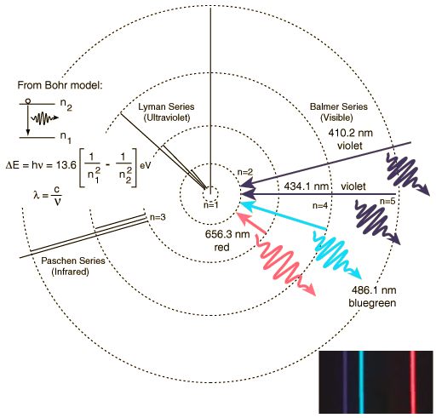
Hydrogen’s Line Spectrum Explained

Slide 25
James Chadwick 1932
Chadwick discovers a third subatomic particle called the neutron
Neutrons are found in the nucleus along with the protons

