Slide 1
Hydrated Compounds
April 2016

Slide 2
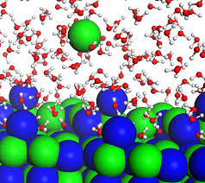
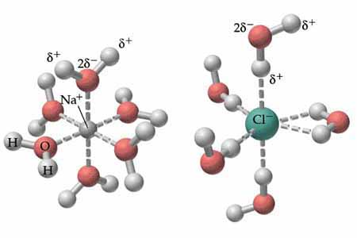
Consider the action of water on a soluble ionic compound:
Water surrounds and separates cations from anions
Water forms a loose “bond” around the cations and anions

Slide 3
The water molecules can be removed in 2 ways:
By heating the solution
2) By letting the solution evaporate the water away
All water molecules break away from the ions:
i.e. CuSO_{4(aq)} → CuSO_{4(s)}
Forming solid anyhydrated copper (II) sulfate
Water molecules remain attached to the cation
i.e. CuSO_{4(aq)} →CuSO₄·5H₂O _{(s)}
Forming solid hydrated copper (II) sulfate

Slide 4
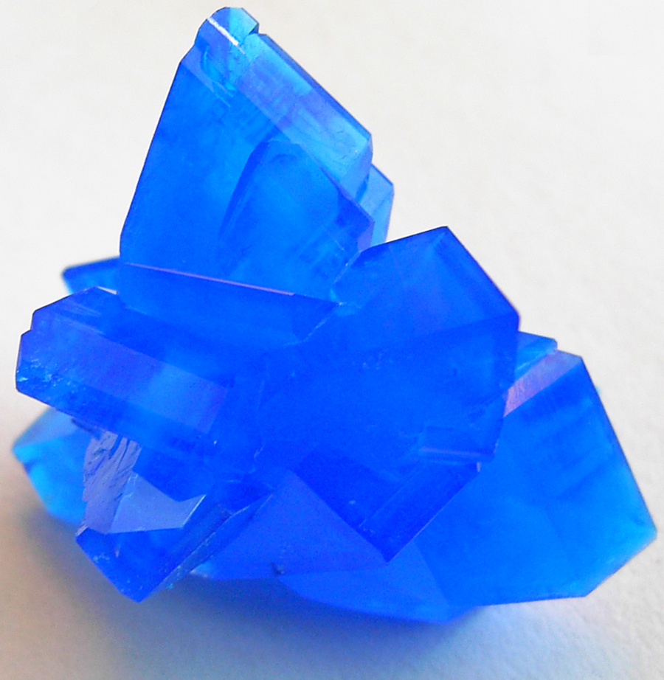
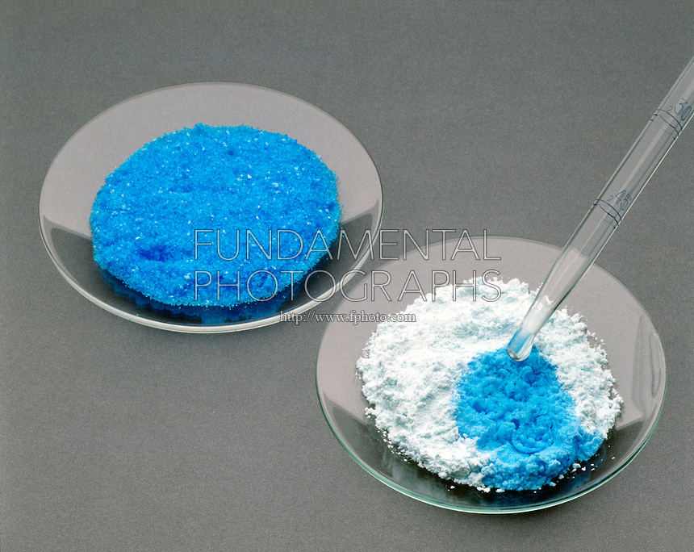
Hydrated and Anhydrated forms of a Compound
Copper (II) sulfate (hydrated)
Copper (II) sulfate (hydrated)
vs
Copper (II sulfate (anhydrated)

Slide 5
Nomenclature of Hydrated Compounds
Name | Formula
 | CuCl₂·2H₂O
Aluminum nitrate nonahydrate
 | Ni(NO₃)₂·6H₂O
Sodium nitrate monohydrate
Nickel (II) sulfate heptahydrate

Slide 6
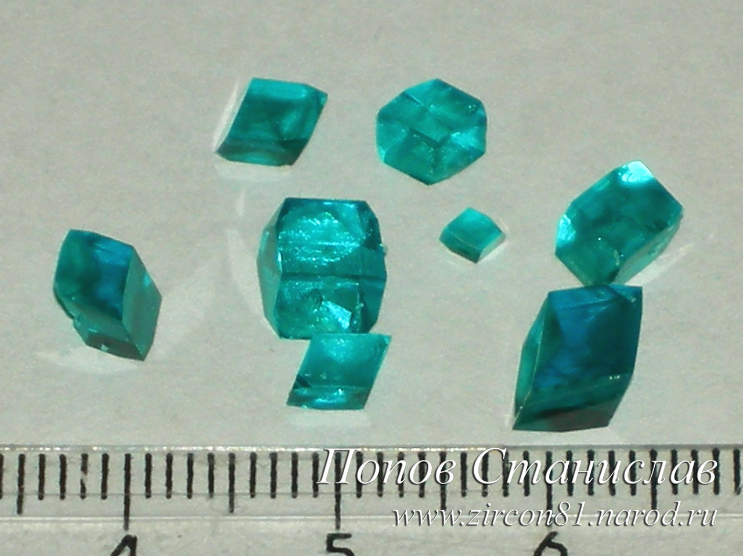
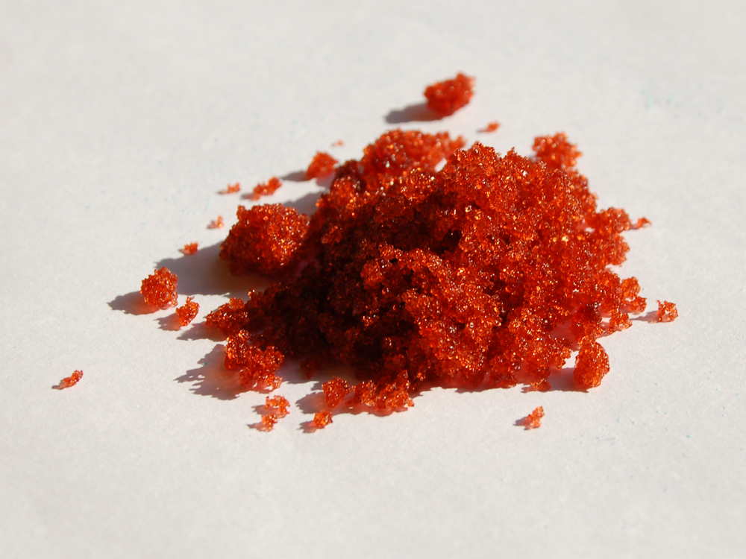
More example of hydrated compounds
NiSO₄ · 7H₂O
Co(NO₃)₂ · 6H₂O

Slide 7
Percent Composition of Hydrated Compounds
Suppose that a sample of a hydrated compound of MnBr₂ is massed and then gently heated to remove the water that is loosely attached to the Mn²⁺.
The following results are obtained:
Mass of hydrated compound before heating: 15.00 g
Mass after heating: 11.23 g
What mass of water was removed?
3.77 g
What is the percent water of the hydrated compound?
25.13%

Slide 8
Percent Composition of Hydrated Compounds
A sample of a hydrated compound of CrCl₃ is massed, gently heated and then remassed.
The following results are obtained:
Mass of hydrated compound before heating: 12.50 g
Mass after heating: 9.32 g
What is the percent water of the hydrated compound?
25.44%
b) What is the value of “x” in CrCl₃.xH₂O?
3

Slide 9
Percent Composition of Hydrated Compounds
Determine the formula of hydrated zinc nitrate that is 36.34% water.
Zn(NO₃)₂.6H₂O
Complete p. 106 #1-5

