Slide 1
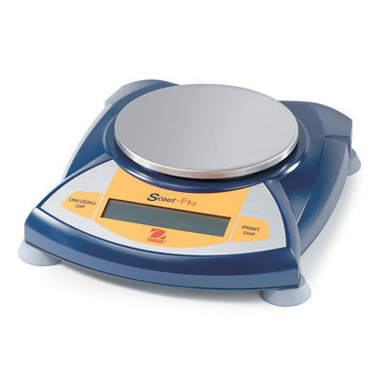
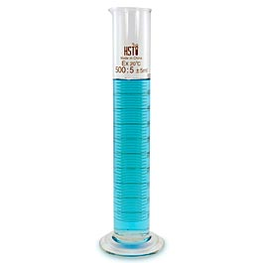
Measurements in Chemistry
Mass
Volume

Slide 2
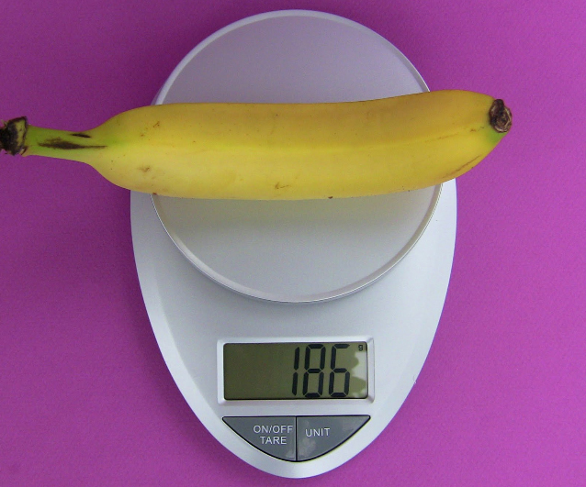
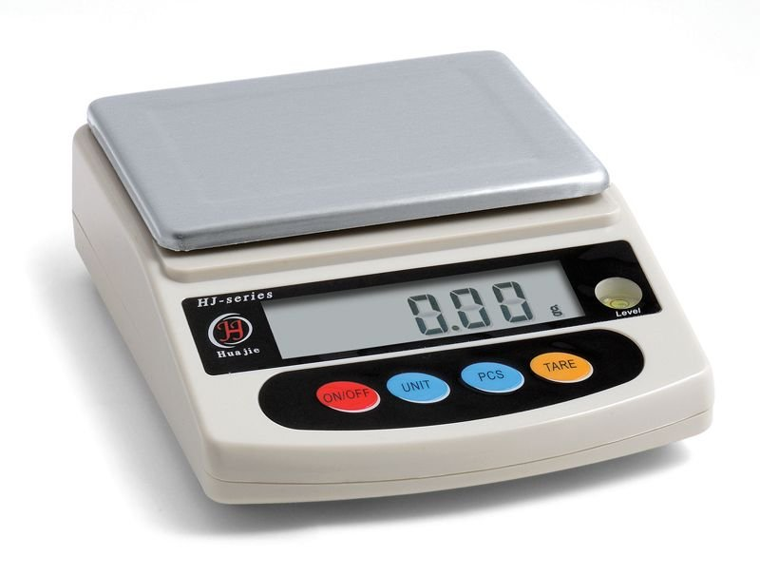
Consider the two balances below:
Balance 1:
the banana has a mass of 186 grams
Balance 2:
the same banana might have a mass of 185.92 g or 186.25 g etc. We CAN’T assume that the mass would be 186.00 g

Slide 3
Significant Digits
The number of digits that we are certain of (significant digits) depend on the graduations of the measuring device
For example:
Using balance 1, the mass of the banana has been measured to _____ significant digits
Using balance 2, the mass of the banana has been measured to _____significant digits
All calculations we perform with measured values must reflect the number of significant digits (for multiplying and dividing) OR the number of decimal places (for adding and subtracting) that the measured value has

Slide 4
Example: 2 objects are massed, one using balance 1 and the other using balance 2
Mass of object 1: 25 g
Mass of object 2: 13.45 g
The total of both masses is 38 g NOT 38.45 g
Why?
We don’t know what the decimal places would have been if object 1 had been massed on balance 2 – we can’t assume it was 25.00 g!

Slide 5
RULE #1:
When adding or subtracting measured values, the answer has the same number of decimal places as the least number of decimal places in the question.
More examples:
10.1 g + 0.32 g =
5.56 g + 1.329 g =

Slide 6
RULE #2:
When multiplying and dividing measured values, the answer has the same number of significant digits as the least number of significant digits in the question.

Slide 7
How to determine the number of significant digits a measured value has:
All non-zero digits are significant
186 has 3 significant digits; 185.89 has 5 significant digits
Zeros between non-zero digits are significant
1806 has 4 significant digits; 108006 has 6 significant digits
Any zero after a decimal point that also has significant digits before the decimal point is significant
623.0 has 4 significant digits; 6023.00 has 6 significant digits
Any zero before a decimal point and before other significant digits is not significant
0.632 has 3 significant digits; 0.00632 has 3 significant digits; 0.63200 has 5 significant digits

Slide 8
How many significant digits?
123.4
0.023
0.00030
8120.0
804
800

Slide 9
Round each number to the number of significant digits indicated:
0.3261 (to 3)
679.5 (to 3)
561 (to 2)
0.00344 (to 2)
540 (to 1)

Slide 10
Measurements with no decimal and ending in zeros make it difficult to determine the precision of the measuring device.
For example, 1860 could be considered to have 3 or 4 significant digits depending on the precision of the measuring device
Writing the value in scientific notation makes it clearer:
1.860 x 10³ or 1.86 x 10³
If the above example is not written in scientific notation, it will be assumed that the zero is significant

Slide 11
Using RULE #2:
Answer the following to the correct number of significant digits:
563 x 21 =
45/ 56.15 =
0.00123 x 0.115 =
0.702 x 1.20 =

Slide 12
Scientific Notation
Measurements in chemistry generate values that range from incredibly large to incredibly small values
For example:
1 gram of iron contains about 10 000 000 000 000 000 000 000 atoms and
1 atom of iron weighs about 0.000 000 000 000 000 000 000 1 grams
Rather than write all those zeros, scientists write these values in scientific notation
The general form for scientific notation is _._ _ x 10?

Slide 13
For numbers greater than one: move the decimal to the left until there is 1 digit in front of it. The number of places the decimal moves becomes the exponent on the 10.
15 000 000 000 000 000 000 000.
= 1.5 x 10²²
Try:
56 000 000
Your calculator can put numbers into scientific notation for you – find the button on your calculator that will do this
Using you calculator, write 923000 in scientific notation

Slide 14
For numbers less than one: move the decimal to the right until there is 1 digit in front of it. The number of places the decimal moves becomes the exponent on the 10, except that now the exponent is negative.
0.000 000 000 000 000 000 000 15
= 1.5 x 10⁻²²
Try:
0.000 000 45

