Slide 1
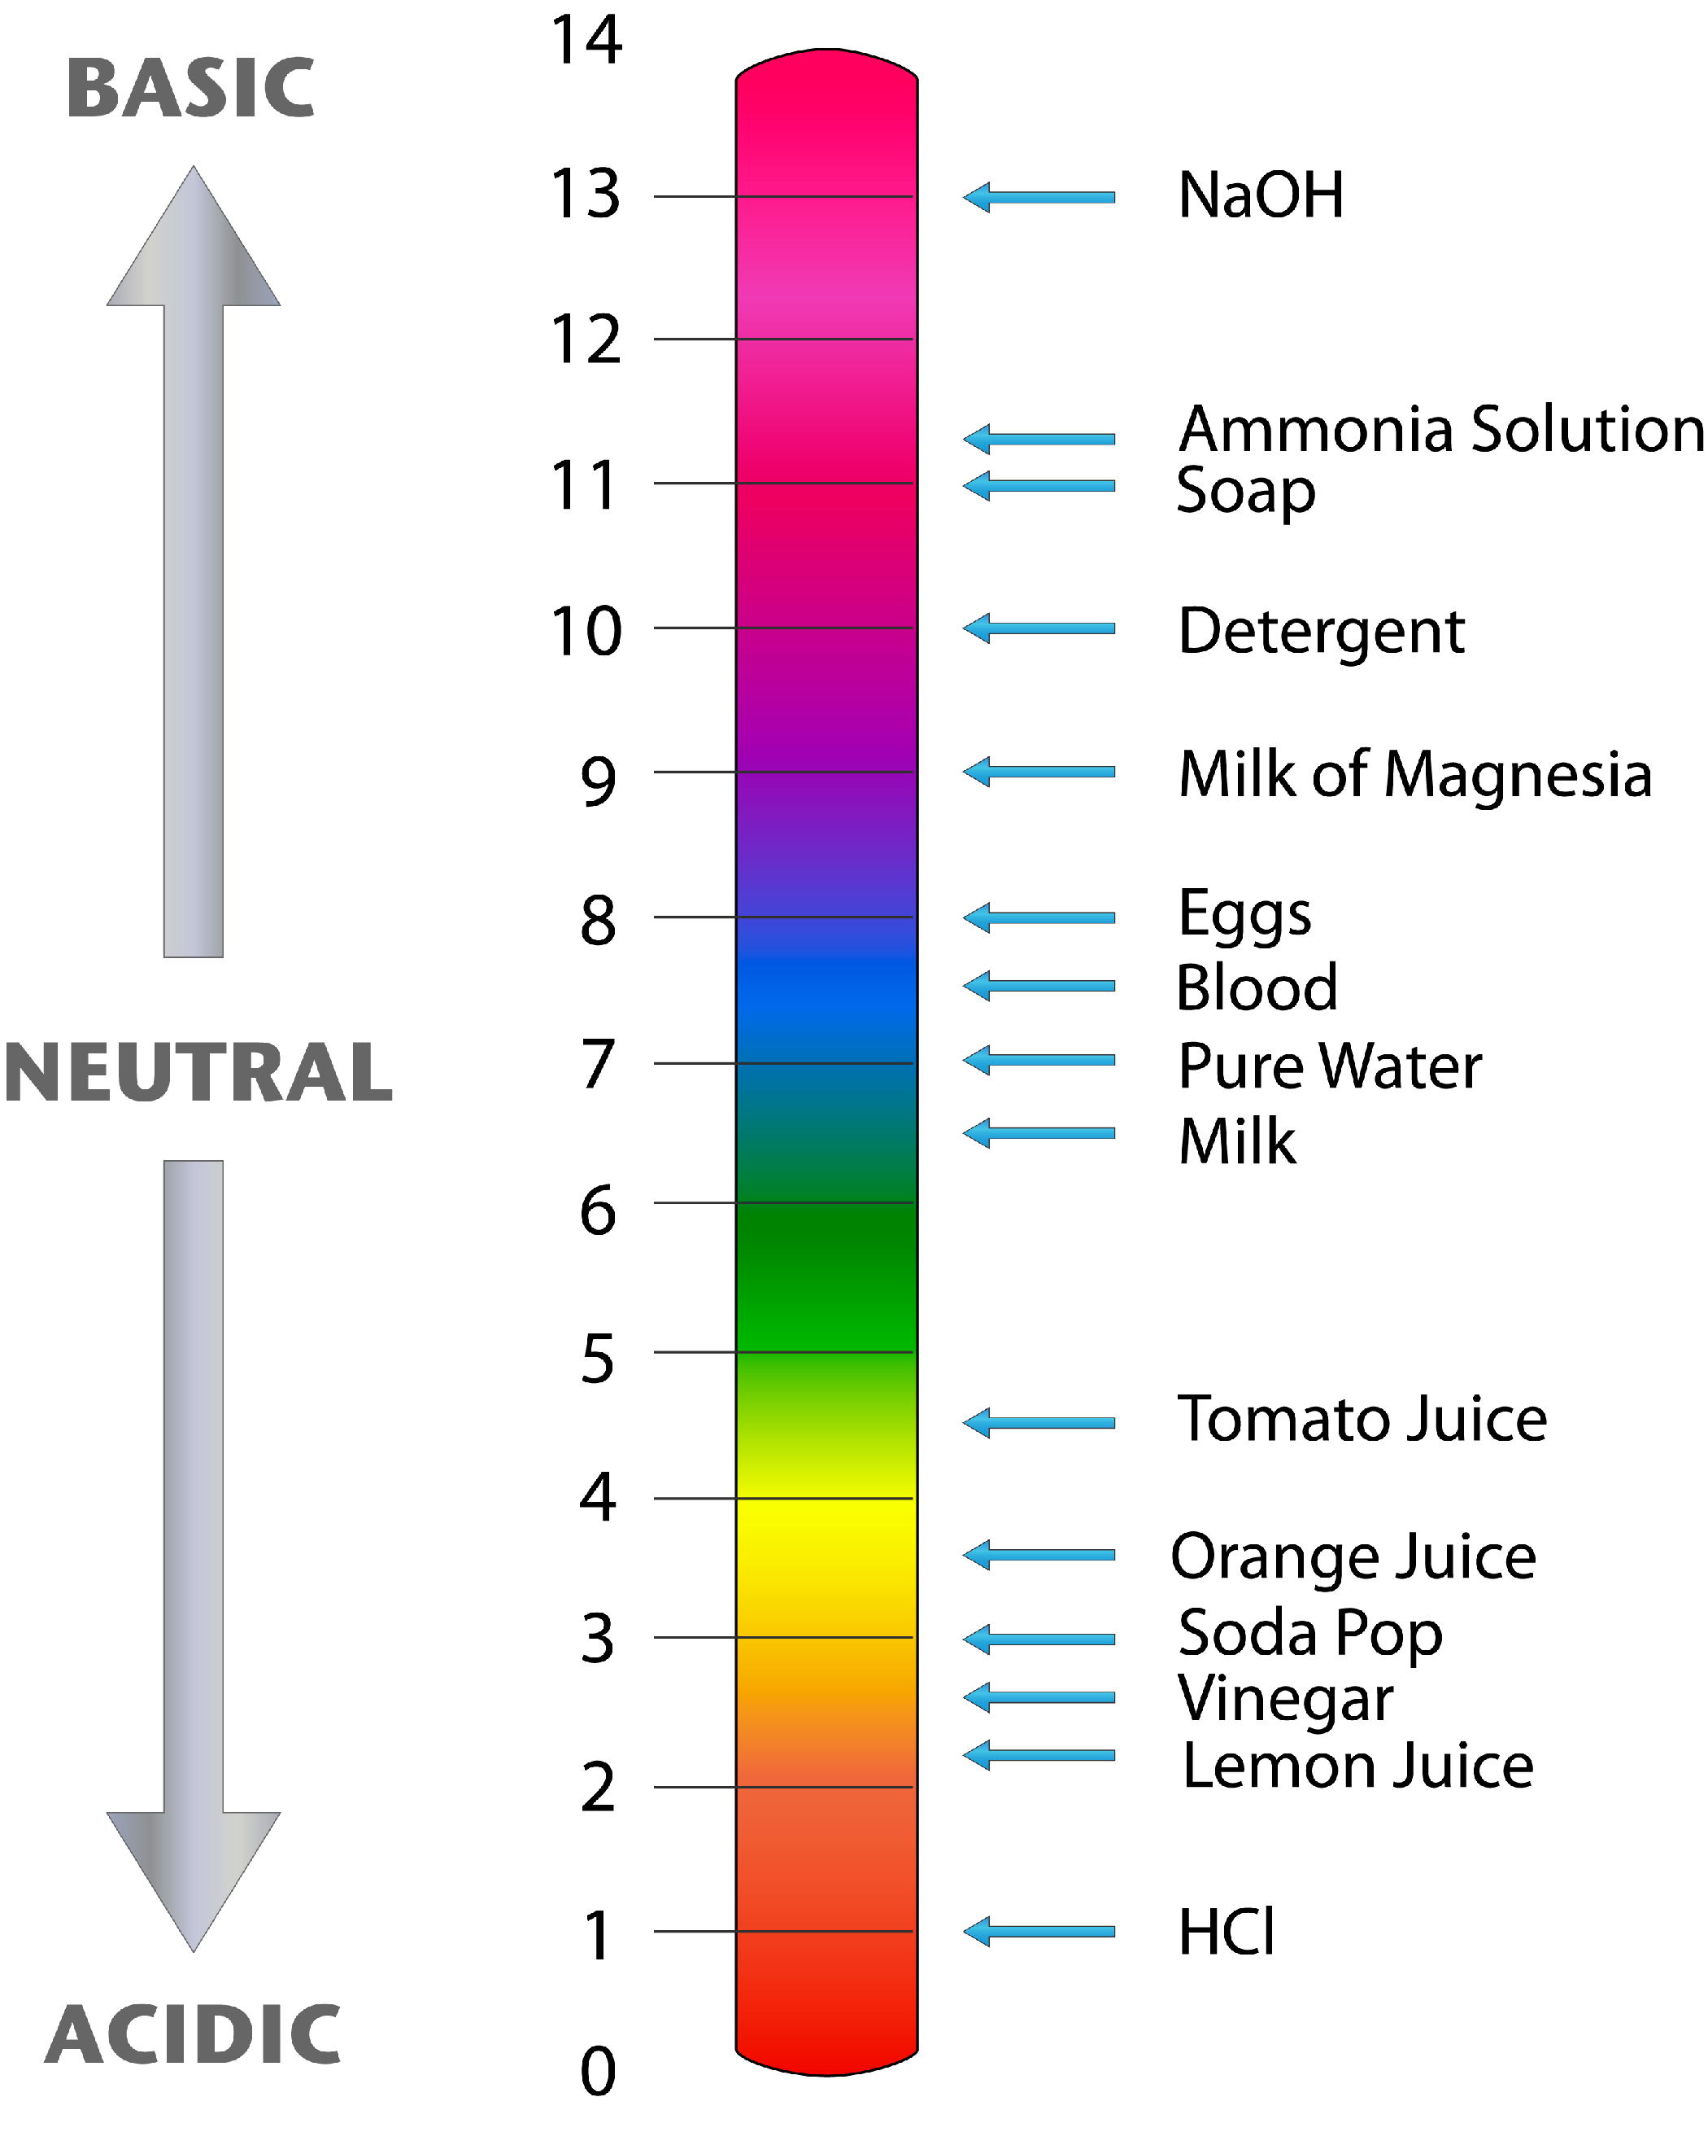
Acids
and
Bases
November 2015

Slide 2
Properties of Acids and Bases
ACIDS | BASES

Slide 3
Arrhenius Theory of Acids and Bases
ACIDS | BASES
Compounds that contain H⁺ H⁺ is responsible for its properties i.e. HCl_{(aq)} | Compounds that contain OH⁻ OH⁻ is responsible for its properties i.e. NaOH_{(aq)}
Both HCl and NaOH are considered to be STRONG

Slide 4
STRONG ACIDS
i.e. HCl
All covalent bonds are between H and Cl are broken by water
HCl_{(aq)} → H⁺_{(aq)} + Cl⁻_{(aq)}
This is called an ionization reaction since ions are being formed from a covalent compound
Strong acids ionize 100% (or close to it)

Slide 5
STRONG BASES
i.e. NaOH
All ionic bonds are broken between Na⁺ and OH⁻ by water
NaOH_{(aq)} → Na⁺_{(aq)} + OH⁻_{(aq)}
Called a dissociation reaction – ions have dissociated or separated from each other.
Strong bases 100% dissociate

Slide 6
Review of pH, pOH

Slide 7
WEAK ACIDS and BASES
Less than 100% of the acid (or base) ionizes
Typically <10%
This leads into the next theory developed by Bronsted and Lowry
Their theory reveals the role of water

Slide 8
BRONSTED-LOWRY ACIDS
Let’s rethink the role of water: it has 2 roles – dissolving the covalent acid and then ionizing the acid
HCl_{(aq)} + H₂O_{(l)} →
B-L acids = are hydrogen ion or proton donors

Slide 9
Using the B-L idea, write the ionization reactions for the following acids:
HNO₃ (strong acid)
2) HF (weak acid)

Slide 10
Calculating pH from % ionization
A 0.10M HF solution is 3.1% ionized. What is the pH of the solution?

Slide 11
Calculating pH from % ionization
A 0.20M HNO₂ solution is 4.3% ionized. What is the pH of the solution?

Slide 12
Weak Acids and ICE: starting with K_{a}
Lactic acid is a weak acid.
Look up the ionization constant for lactic acid (K_{a})?
Write the ionization reaction for lactic acid
The concentration of lactic acid is 0.050M. What is the pH of the solution of lactic acid BEFORE it begins to ionize?
Create an ICE chart that reflects the ionization of lactic acid.
What is: a) the percent ionization of lactic acid?
b) the pH of the lactic acid solution?

Slide 13
Weak Acids and ICE: starting with K_{a}
What is:
a) the percent ionization of 0.010M hydrocyanic acid, HCN?
b) the pH of 0.010M HCN?

Slide 14
Weak Acids and ICE: starting with % ionization
1.3% of 0.10M acetic acid is ionized. What is the a) K_{a}, b) pH of the acetic acid?

Slide 15
Weak Acids and ICE: starting with pH
The pH of 0.10M methanoic acid, HCO₂H, is 2.4. what is its K_{a} and % ionization?

Slide 16
Weak Acids and ICE: starting with pH
The pH of 0.50M benzoic acid, HC₇H₅O₂, is 2.2. what is its K_{a} and % ionization?

Slide 17
BRONSTED-LOWRY BASES
i.e. NH₃
Again let’s consider the role that water plays in the dissolving and ionizing of NH₃:
NH_{3(aq)} + H₂O_{(l)} →
B-L base = hydrogen ion or proton acceptors

Slide 18
BRONSTED-LOWRY ACIDS & BASES
B-L acid = hydrogen ion or proton donor
B-L base = hydrogen ion or proton acceptors
In light of the above definitions, identify all B-L acids and bases in the equation:
HNO_{2(aq)} + H₂O_{(l)} ←→ H₃O⁺_{(aq)} + NO₂⁻_{(aq)}

Slide 19
Weak Bases and ICE: starting with K_{b}
What is:
a) the percent ionization of 0.10M ammonia, NH₃?
b) the pH of 0.10M NH₃?

Slide 20
Weak Bases and ICE: starting with K_{b}
What is:
a) the percent ionization of 0.025M hydrazine, N₂H₄?
b) the pH of 0.025M N₂H₄?

Slide 21
Weak Bases and ICE: starting with % ion’n
0.20M C₅H₅N ionizes 0.0092%. What is its K_{b} and pH?

Slide 22
Weak Bases and ICE: starting with pH
0.10M morphine, C₁₇H₁₉NO₃, has a pH of 10.4. What is its K_{b} and % ionization?

