Slide 1
Maxwell-Boltzmann Curves
October 2016

Slide 2
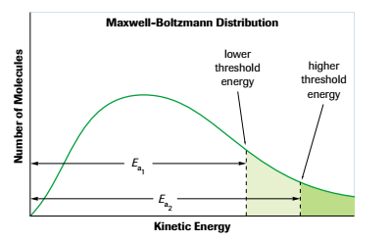
Effect of Nature of Reactant

Slide 3
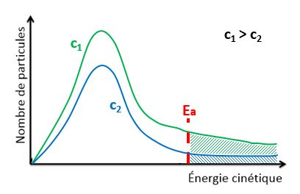
Effect of Concentration

Slide 4
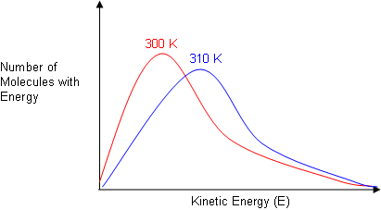
Effect of Temperature

Slide 5
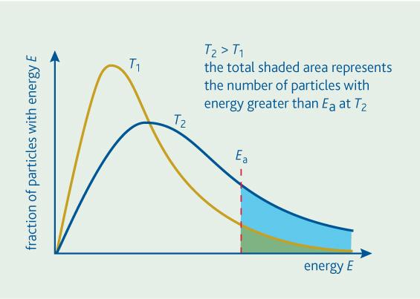
Effect of Temperature

Slide 6
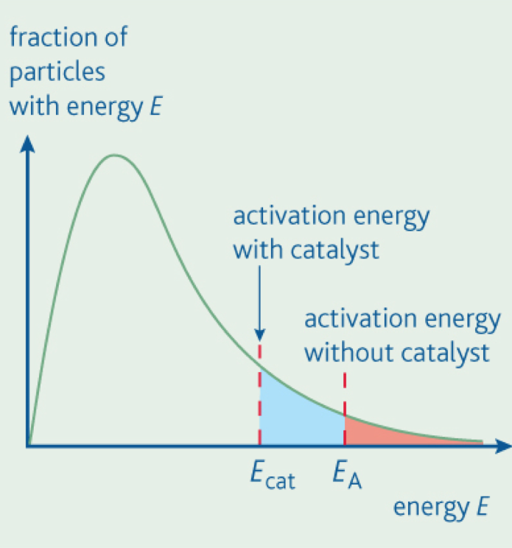
Effect of a Catalyst

