Slide 1
Catalysis
October 2015

Slide 2
Catalyst
A substance that speeds up a reaction without being consumed itself
How? By providing a new pathway for the reaction, one with a lower activation energy

Slide 3
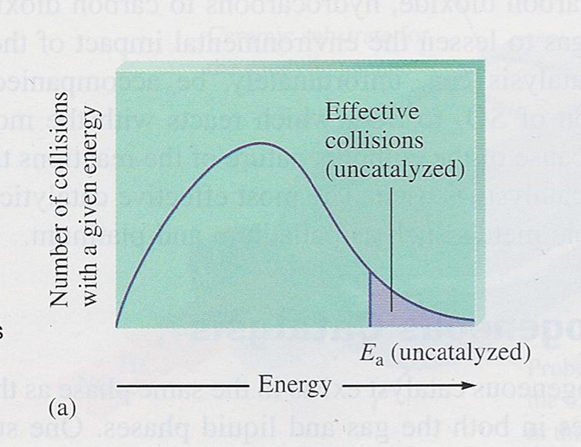
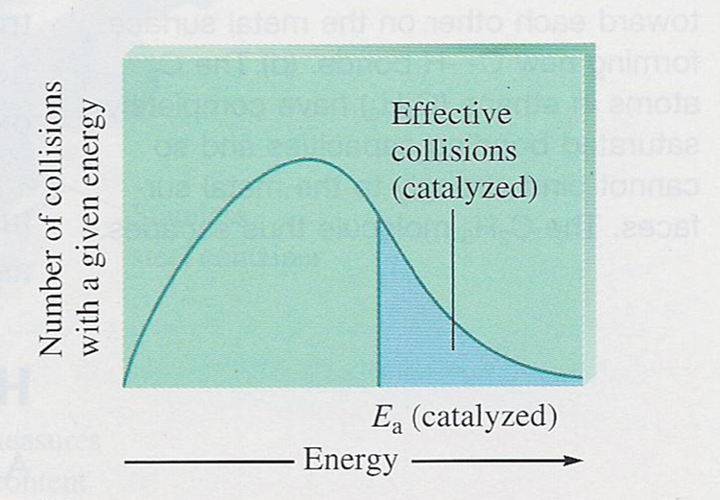
Catalyzed Reaction
Note: a greater fraction of the collisions are effective therefore the reaction rate increases
Uncatalyzed Reaction
Catalyzed Reaction

Slide 4
Catalysts can be classified as:
Homogeneous – where the catalyst is in the same phase as the reactants
2) Heterogeneous – where the catalyst is in a different phase – usually a solid

Slide 5
Heterogeneous catalysts
Consider the following reaction:
C₂H₄ + H₂ → C₂H₆

Slide 6
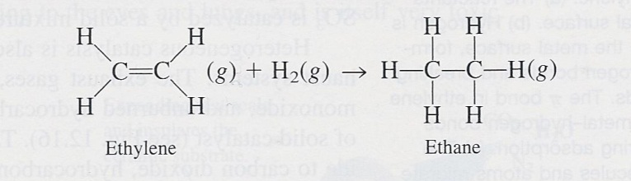
The reaction is slow; most of the activation energy is used to break the strong H-H bond

Slide 7
The reaction rate can be greatly increased in the presence of:
Platinum
Palladium
Nickel

Slide 8
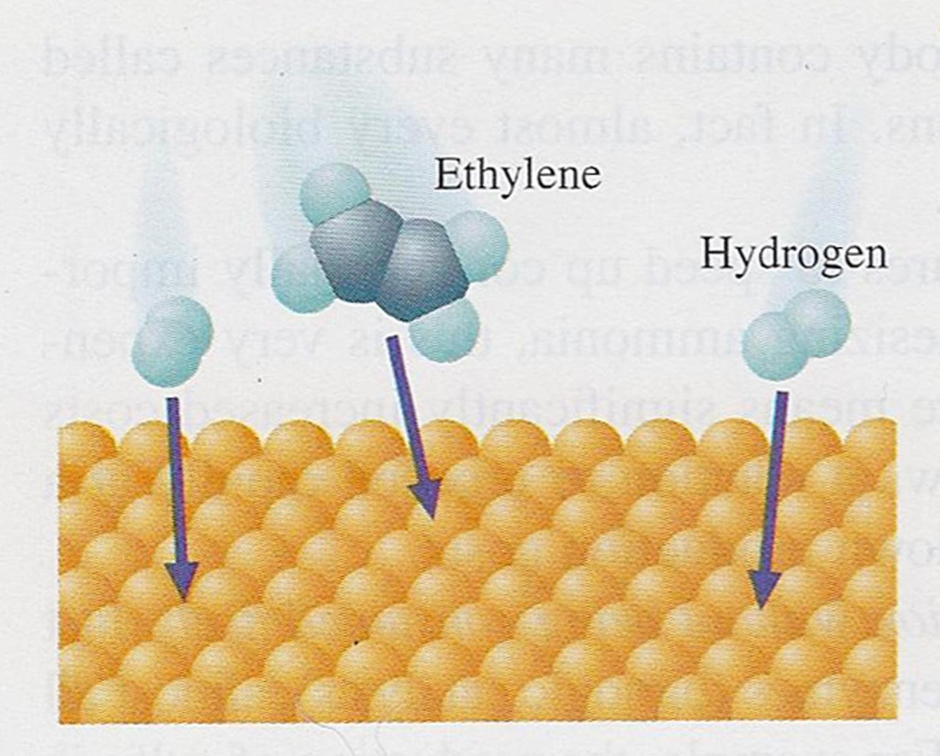
1) The reactants are adsorbed (loosely attached) onto the surface of the nickel
2) Ni–H bonds are formed as H-H bonds break

Slide 9
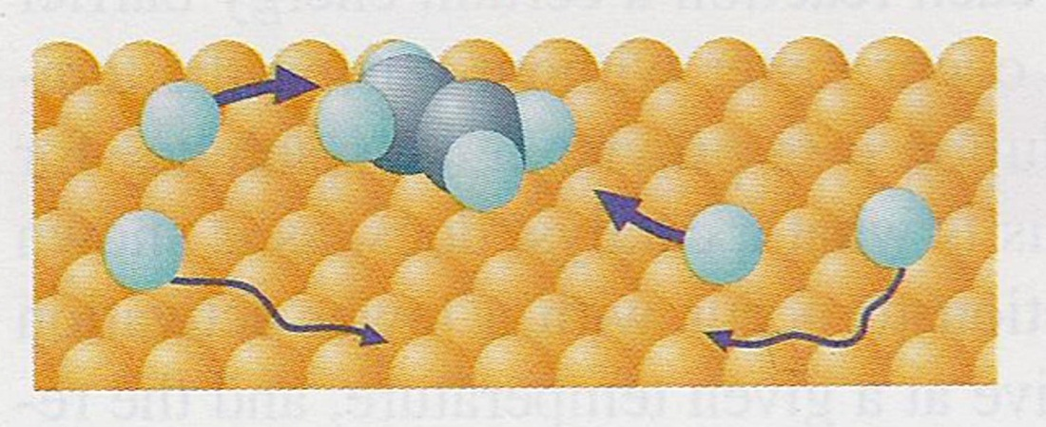
3) Molecules and atoms migrate toward each other

Slide 10
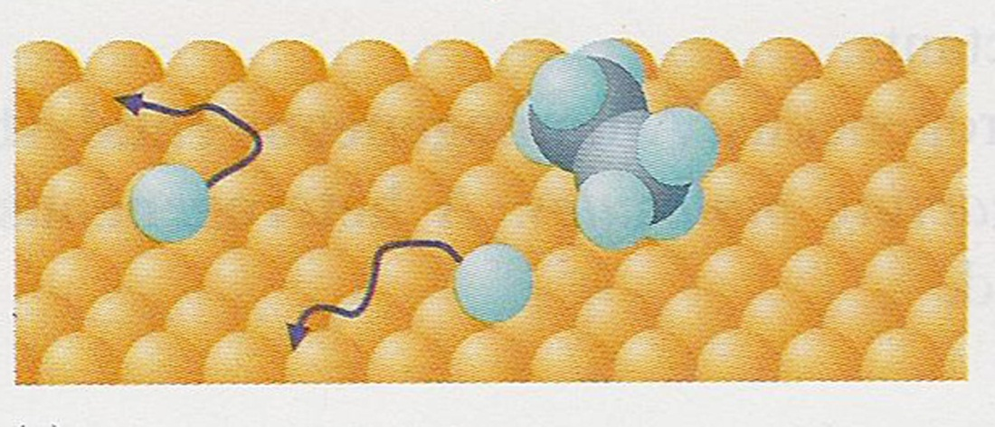
4) C-H bonds are formed

Slide 11
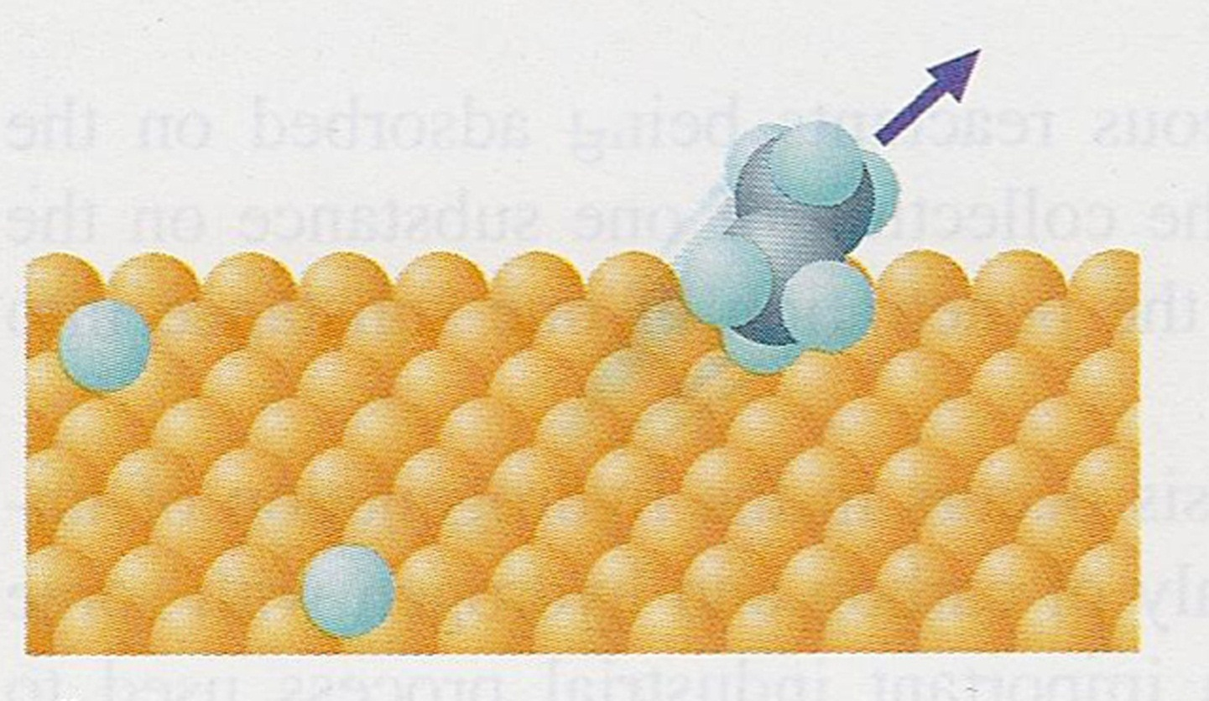
5) The product ethane is released from the surface of the Ni (desorbed)
6) The Ni remains unchanged and can be used over and over again

Slide 12
Homogeneous catalysts
Provide a completely new reaction mechanism that has a faster slow step than the slow step of the uncatalyzed reaction
What must be true about the E_{a} of the catalyzed mechanism’s slow step?

Slide 13
Consider the reaction:
2H₂O_{2(l)} → 2H₂O_{(l)} + O_{2(g)}
The reaction is very slow
If rate = k[H₂O₂]² propose a mechanism

Slide 14
BUT with a catalyst:
H₂O₂ + I⁻ → H₂O + IO⁻ (slow)
H₂O₂ + IO⁻ → H₂O + O₂ + I⁻ (fast)
What is the catalyst?
What is the reaction intermediate?
What must be true of the activation energy of the slow step?

Slide 15
Identify the catalyst and reaction intermediate:
Cl_{(g)} + O_{3(g)} → ClO_{(g)} + O_{2(g)}
O_{(g)} + ClO_{(g)} → Cl_{(g)} + O_{2(g)}

