Slide 1
Reaction mechanisms
Are one-step or multi-step pathways that a reaction follows, indicating the order in which collisions occur
Are best-guesses at how the reaction occurs and can only be determined from the experimentally determined rate law.

Slide 2
Reaction mechanisms
Step 1: A + B → C
Step 2: A + C → D
Overall reaction: 2A + B → D
Each step is called an elementary step
most elementary steps involve 1 or 2 particles colliding

Slide 3
A reaction intermediate is always formed.
An intermediate is a substance which is formed and then in a later step is used up again.

Slide 4
Which substance is the reaction intermediate in the example below?
Step 1: A + B → C
Step 2: A + C → D
2A + B → D

Slide 5
One step is always slower than the rest and an important part of the mechanism is to indicate which steps are fast and which is slow.
Step 1: A + B → C (slow)
Step 2: A + C → D (fast)
2A + B → D

Slide 6
Reaction mechanisms and the rate law
A rate law can be written for each elementary step using the idea that rate α # of collisions
Step 1: A + B → C (slow)
Rate = k [A][B]
Step 2: A + C → D (fast)
Rate = k [A][C]

Slide 7
Consider the following reaction mechanism:
HBr_{(g)} + O_{2(g)} → HOOBr_{(g)} (slow)
HOOBr_{(g} + HBr_{(g)} → 2HOBr_{(g)} (fast)
HOBr_{(g)} + HBr_{(g)} → H₂O_{(g)} + Br_{2(g)} (fast)
HOBr_{(g)} + HBr_{(g)} → H₂O_{(g)} + Br_{2(g)} (fast)
4HBr_{(g)} + O_{2(g)} → 2H₂O_{(g)} + 2Br_{2(g)}
What is the overall reaction?
What reaction intermediates are formed?
Consider the following potential energy diagram for the above reaction.

Slide 8
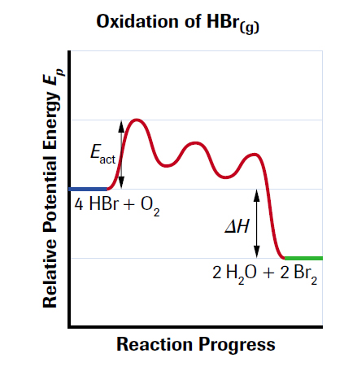
What do you notice about the slow step?

Slide 9
RATE DETERMINING STEP
Is the slowest elementary step in the reaction mechanism
The rate law from the slowest step IS the rate law for the overall reaction

Slide 10
Consider the following reaction mechanism:
Step 1: A + B → C (slow) ΔH = -40 kJ
Step 2: A + C → D (fast) ΔH = -60 kJ
2A + B → D ΔH = ?
What is the rate law for the reaction
2A + B → D?
Rate = k [A][B]
2) Try drawing the overall PE diagram and then the 2-step PE diagram.

Slide 11
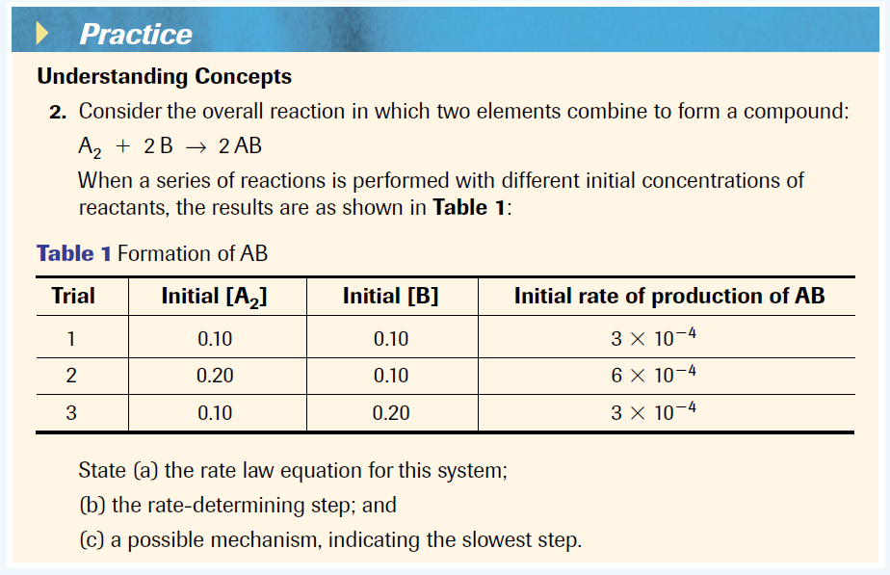
Creating Reaction Mechanisms (Page 390 #2)

Slide 12
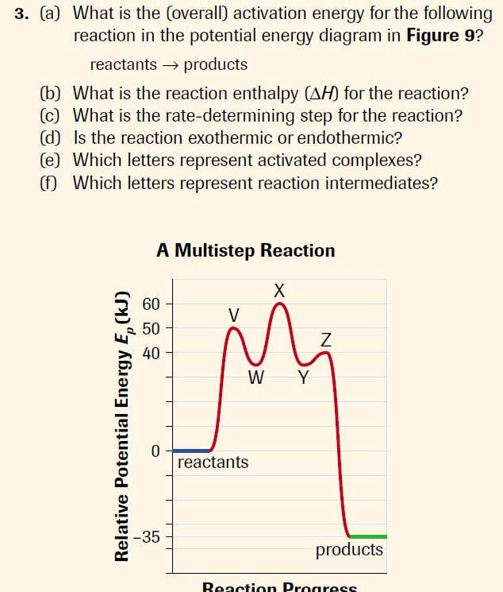
Page 391 #3

