Slide 1
Rate Law

Slide 2
Example 1:
N₂O₅ → 2NO + ½ O₂
[N₂O₅] (mol/L) | Rate of formation of O₂ (mol/Ls)
0.45 0.90 1.35 | 2.7 x 10⁻⁴ 5.4 x 10⁻⁴ 8.2 x 10⁻⁴

Slide 3
CH₃CHO → CH₄ + CO
[CH₃CHO] (mol/L) | Rate of formation of CO (mol/Ls)
0.10 0.20 | 8.6 x 10⁻⁴ 3.44 x 10⁻³

Slide 4
(CH₃)₃CBr + OH⁻ → (CH₃)₃COH + Br⁻
[(CH₃)₃CBr] mol/L | [OH⁻] mol/L | Rate of formation of Br⁻
0.10 0.20 0.10 | 0.10 0.10 0.20 | 4.0 x 10⁻³ 8.0 x 10⁻³ 4.0 x 10⁻³

Slide 5
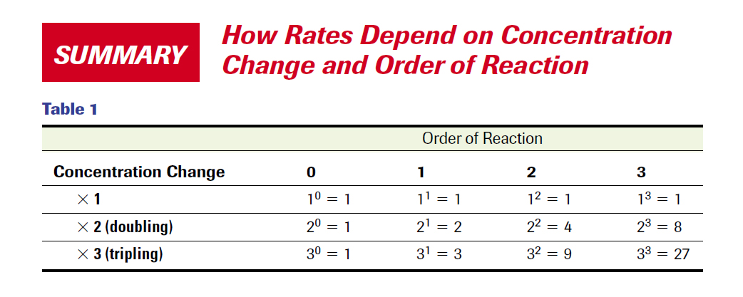

Slide 6
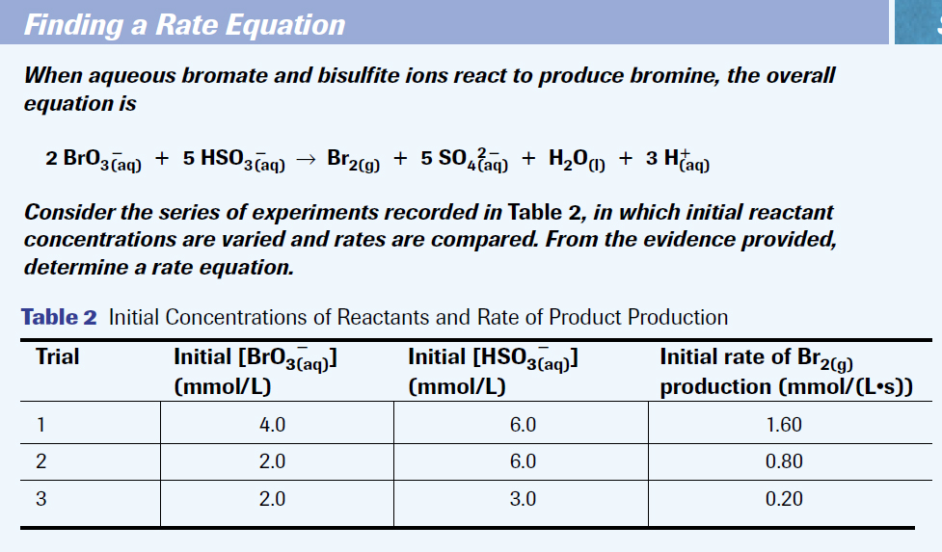

Slide 7
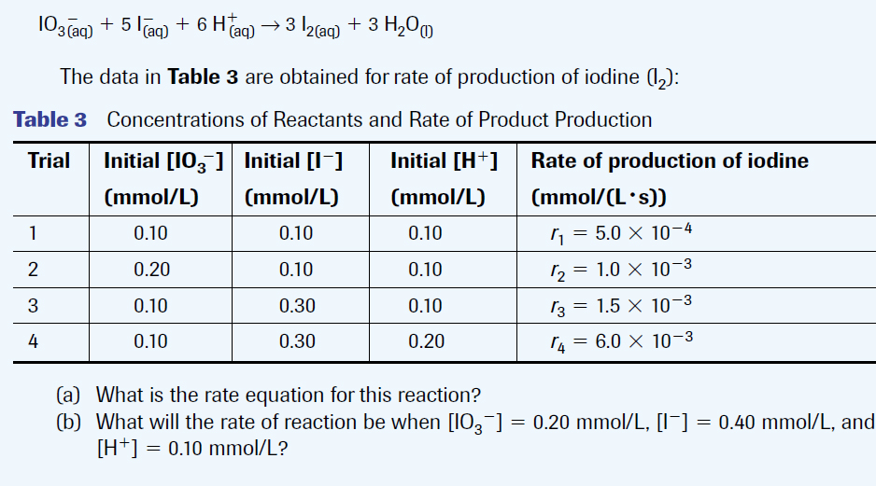

Slide 8
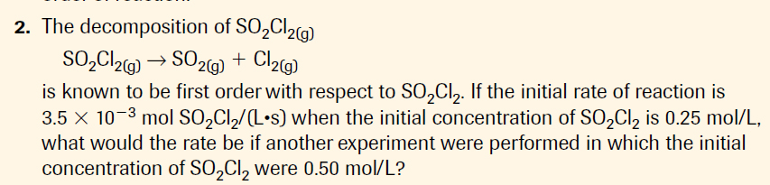

Slide 9
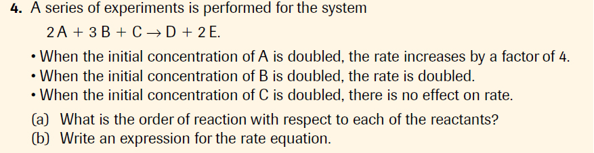

Slide 10
