Slide 1
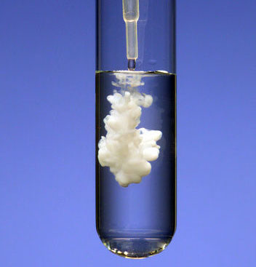
Predicting Precipitate Formation

Slide 2
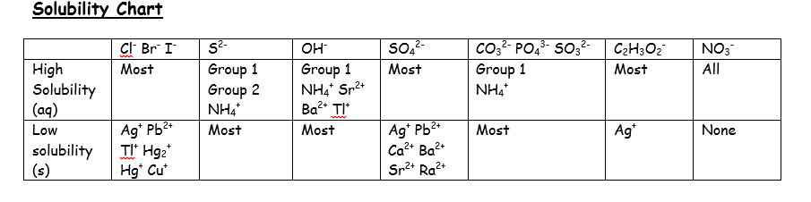
BaCl_{2(aq)} + Na₂SO_{4(aq)} → ___ + ___

Slide 3
BaCl_{2(aq)} + Na₂SO_{4(aq)} → BaSO_{4(s)} + 2NaCl_{(aq)}
Create the ionic and net ionic equations for the above.

Slide 4
Ba²⁺ _{(aq)} + SO₄²⁻ _{(aq)} → BaSO_{4(s)}
To quantify the precipitate formations, reverse the above net ionic equation.
K_{sp} for BaSO₄ = ?
If solutions of BaCl₂ and Na₂SO₄ are mixed so that the concentration of each solution is 0.10M, what is the nature of the resulting solution?
ICE chart

Slide 5
Will a precipitate form?
A solution of AgNO₃ is mixed with KOH so that
[AgNO₃ ]is 0.0010M and [KOH] is 0.0020M.
What is likely to precipitate?
What is the K_{sp} of AgOH?
What is the nature of the solution?
Will a precipitate form?

Slide 6
Will a precipitate form?
A solution of AgNO₃ is mixed with Ba(OH)₂ so that [AgNO₃ ]is 0.00010M and [Ba(OH)₂] is 0.00020M.
What precipitate is likely to form?
Will it form?

Slide 7
Will a precipitate form?
50.0 mL of 0.010M CaS is mixed with 50.0 mL of 0.0020M ZnCl₂ .
What precipitate is likely to form?
Will it form?

Slide 8
Will a precipitate form?
10.0 mL of 0.010M Ca(NO₃)₂ is mixed with 90.0 mL of 0.0010M NaOH.
What precipitate is likely to form?
Will it form?

Slide 9
Will a precipitate form?
100.0 mL of 0.010M Sr(NO₃)₂ is mixed with
400.0 mL of 0.020M Na₂SO₄ .
What precipitate is likely to form?
Will it form?
How much precipitate will form?

Slide 10
Will a precipitate form?
100.0 mL of 0.010M Pb(NO₃)₂ is mixed with
300.0 mL of 0.010M Na₂SO₄ .
What precipitate is likely to form?
Will it form?
How much precipitate will form?

Slide 11
Will a precipitate form?
10.0 mL of 0.010M CaCl₂ is mixed with
20.0 mL of 0.060M Na₂CO₃.
How much precipitate will form?

Slide 12
Will a precipitate form?
50.0 mL of 0.10M AlCl₃ is mixed with
150.0 mL of 0.20M AgNO₃.
How much precipitate will form?

