Slide 1
The Mole:
It’s a Big Deal in Chemistry!
October 2017

Slide 2
What is the Mole?
Check this out:
https://www.youtube.com/watch?v=KLxhdPNXC_k

Slide 3
Every day we use common terms that represent numbers
For example, we can say….
12 donuts or a ___________
365 days or a ______________
$1000 or a ______________
60 minutes or an __________
You get the idea!

Slide 4
In chemistry, we have a term that represents a crazy big number: the mole
602,000,000,000,000,000,000,000
=
1 mole

Slide 5
So, just how big is a mole? A mole is so big that….
Check this out:
https://www.youtube.com/watch?v=TEl4jeETVmg

Slide 6
Why do we need the mole in chemistry?
Because atoms and even molecules are way too small for us to ever be able to see.
Did you know that even though a mole of donuts might cover the whole earth to a depth of --- m, a mole of table salt is about a teaspoon of salt?
That’s because the sodium and chloride ions are sooooo small that you need this crazy big amount just to be able to see them.

Slide 7
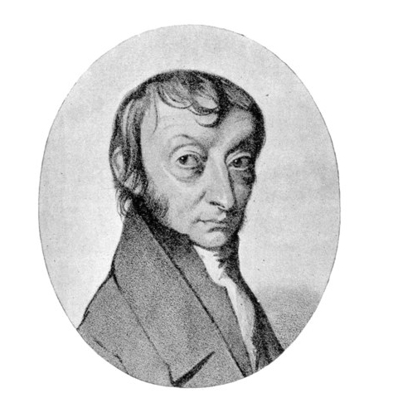
Who came up with the idea of a mole?
A guy named Avogadro and so the number
602,000,000,000,000,000,000,000
is often called Avogadro’s Number

